Slide 1
NVMe Health Monitoring and Fault Prediction
Presented By:
Priyam Saxena
Prathik P S
Govind Satwani
Shreesha Bhat
Tanmay Srinath
Guided By:
Nidugala Murali
Salvi Nilesh Anant
A K Rajesh
Nallasamy Shanmugaraja
Dr. V Shubha Rao

Slide 2
Contents
Problem Statement
Existing System
Methodology
Output Snapshots
Tools Required
Future Work
Conclusion
References

Slide 3
Problem Statement
Our Problem is to do the error analysis of the system (NVME drives) in terms of parameters like temperature, available space etc.
Error analysis can be done by getting the threshold values of each parameters and then compare the current NVME drive parameters with the threshold values.
Through this analysis, we can predict the performance of the system.

Slide 4
Existing System
The existing system comprises of a Smart Log.
This Smart Log doesn’t provide us with much information on what’s good or bad for the NVMe, thus requiring the need for an improved method.
New and improved approaches need to be brought into use for better monitoring and fault detection in NVMe.
Moreover, the existing systems are more suitable for high-capacity drives. To monitor drives used for day-to-day purposes, the existing approaches need to be modified.

Slide 5
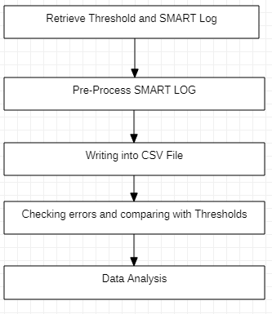
Methodology
Flowchart

Slide 6
Step-1:Retrieving Threshold Parameters and SMARTLOG File:
Load Threshold Parameters by loading the “threshold.json” file.
Creating a table that compares current value of NVME drive parameters with threshold values.
Extract the list of NVME drives in the system.
Taking user input.
Running the SMART log command for the given NVME drive and storing it in a “smartLog.txt” file
Step-2:Pre-process SMARTLOG:
Extract the “smartLog.txt” file.
Remove empty spaces and separate lines as list of key value pairs.

Slide 7
Step-3:Writing into CSV File:
Writing the list of key-value pairs into “log.csv”file.
Step-4:Checking errors and comparing with thresholds:
5 Parameters are used to compare against their thresholds.They are:
Temperature shouldn't cross 40 C
Available Spare should not drop below 11%
Power On Hours for an NVME Drive is rated at 44000. Above this value there are risks of failure.
There should not be too many unsafe shutdowns
Media errors should not cross a certain range, or there is a high chance that the drive will fail.

Slide 8
Step-5:Data Analysis
Checking whether the device is overheated or not using the temperature parameter.
If Temperature drops below the threshold,then counter will reset.

Slide 9
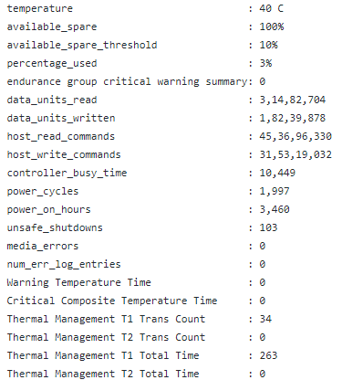
SmartLog

Slide 10
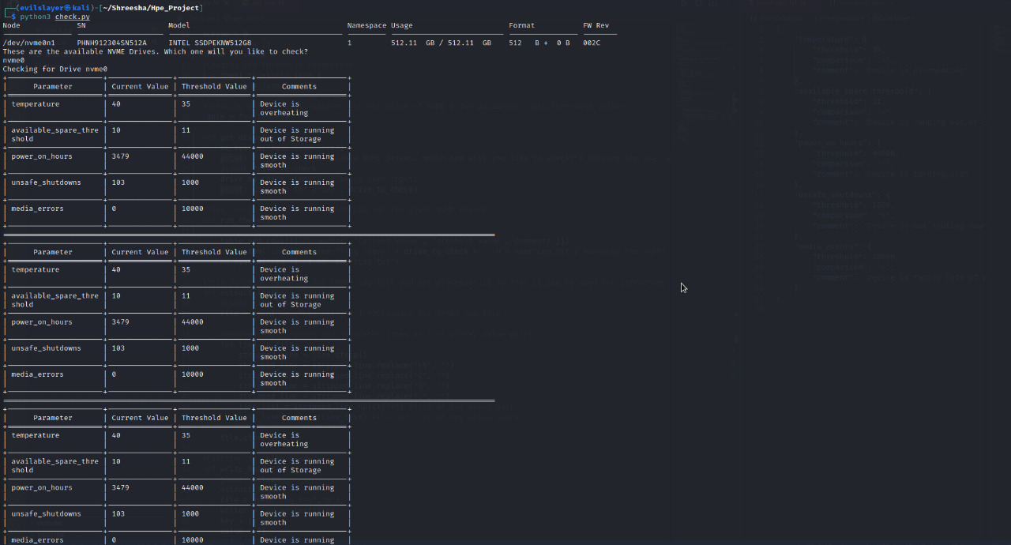
Output Snapshots

Slide 11
Tools Required
Linux(Ubuntu/VMWare)
Command Line interface: nvme
python3

Slide 12
Future Work
Our next goal is to improve the current model, by developing an analysis engine and making use of suitable machine learning techniques.
This will in turn, automate the process of identifying the errors in NVMe, and take suitable steps to resolve them.
If a new error is encountered, it is added to the dataset used for the ML model, and suitable solutions for it can be developed.

Slide 13
Conclusion
We conclude our project by developing a python script that checks the current state of NVMe drives using information gathered from Command line “SmartLog”.
The threshold values for certain parameters can be decided upon by the user. These threshold values are compared against the values obtained from the log, and if these values go beyond the threshold values, the user is intimidated that an error may have occurred, and that the NVMe drive needs to be either repaired or replaced.

Slide 14
References
[1] Yang, Z., Hoseinzadeh, M., Wong, P., Artoux, J., Mayers, C., Evans, D.T., Bolt, R.T., Bhimani, J., Mi, N. and Swanson, S., 2017, December. H-NVMe: a hybrid framework of NVMe-based storage system in cloud computing environment. In 2017 IEEE 36th International Performance Computing and Communications Conference (IPCCC) (pp. 1-8). IEEE.
[2] Khatri, N. and Chakrabarti, S., 2020. NVMe and PCIe SSD Monitoring in Hyperscale Data Centers. arXiv preprint arXiv:2003.11267.

Slide 15


